Slide 1



Lateral reading method for reliable information search
Notes:
Detecting and debunking manipulative content is enhanced by reading and analysing the text, which can be effectively developed through various techniques that are easily applied to everyday life. A crucial habit that accompanies internet browsing is lateral reading. In this lesson, using the lateral reading method, you will learn how to distinguish between credible and misleading information, check a source’s credibility, evaluate textual and visual information, analyse the text and pay more attention to details.

Slide 2
AIM OF THE LESSON
Introduce the concept and method of lateral reading and show how to apply this technique to everyday life.
2
Notes:
Aim of the lesson – introduce the concept and method of lateral reading and show how to apply this technique to everyday life.

Slide 3
LEARNING OBJECTIVES
1
2
Identify the characteristics of a reliable source.
Learn how to evaluate textual and visual information in terms of credibility.
3
Develop skills in text analysis, pay attention to detail, and understand the importance of slower content consumption.
3
Notes:
Learning objectives:
Identify the characteristics of a reliable source.
Learn how to evaluate textual and visual information in terms of credibility.
Develop skills in text analysis, pay attention to detail, and understand the importance of slower content consumption.

Slide 4

WHAT IS LATERAL READING?
Searching for information within a source and exploring multiple perspectives and sources simultaneously.
Strategy for determining a source’s reliability by comparing the information it contains with other sources
4
Notes:
Lateral reading is an essential media literacy skill that involves searching for information within a source and exploring multiple perspectives and sources simultaneously. This method allows each person to assess the credibility and validity of the information they encounter.
Moreover, lateral reading is an effective strategy for determining a source’s reliability. By comparing the information it contains with other sources, you can verify claims and gain more contextual information about the source. This method, used by professional fact-checkers, is a key tool in their daily work to check a source’s credibility.

Slide 5

WHAT DOES LATERAL READING HELP TO ASSESS?
What is the quality of the site you visit (how much information is accurate)?
What content is published and how can we understand it?
Does the site have an editorial process (is it edited and reviewed)?
Does the site have an expert reputation (indicating accuracy of the facts)?
5
Notes:
Lateral reading helps the reader to assess the quality of the site he or she is visiting in terms of the accuracy of the information, provides a broader perspective on the content published there, and helps to understand whether the site has an editorial process or an expert reputation that would allow it to accept the accuracy of the site’s facts.

Slide 6
WAYS OF ADAPTING LATERAL READING
Opening multiple browser tabs
For professional fact-checkers
Combining different information
For readers
Comparing different sources
6
Notes:
Processing information this way involves spending relatively little time on the same website about which more information is to be found. Instead, one steps back from the page and looks at what other reliable sources have said about the site. For example, opening multiple browser tabs, combining different information from across the internet, and comparing different sources to better understand the site under study.
Many of the questions asked by professional fact-checkers are the same as those asked by vertical readers scrolling up and down the source pages being evaluated. Unlike these readers, however, they understand that the truth is more likely to be found in the web of links to (and comments about) a site than on the site itself.

Slide 7
GROUP WORK
Using the example of disinformation and all available open sources to find out:
as much information as possible about the website where the example was posted,
the author of the article or message,
identify which information in the example is correct and which is not,
assess the credibility of the example.
7
Notes:
The aim of the task is to use all available open sources to find out:
as much information as possible about the website where the example was posted,
the author of the article or message,
identify which information in the example is correct and which is not,
assess the credibility of the example.

Slide 8
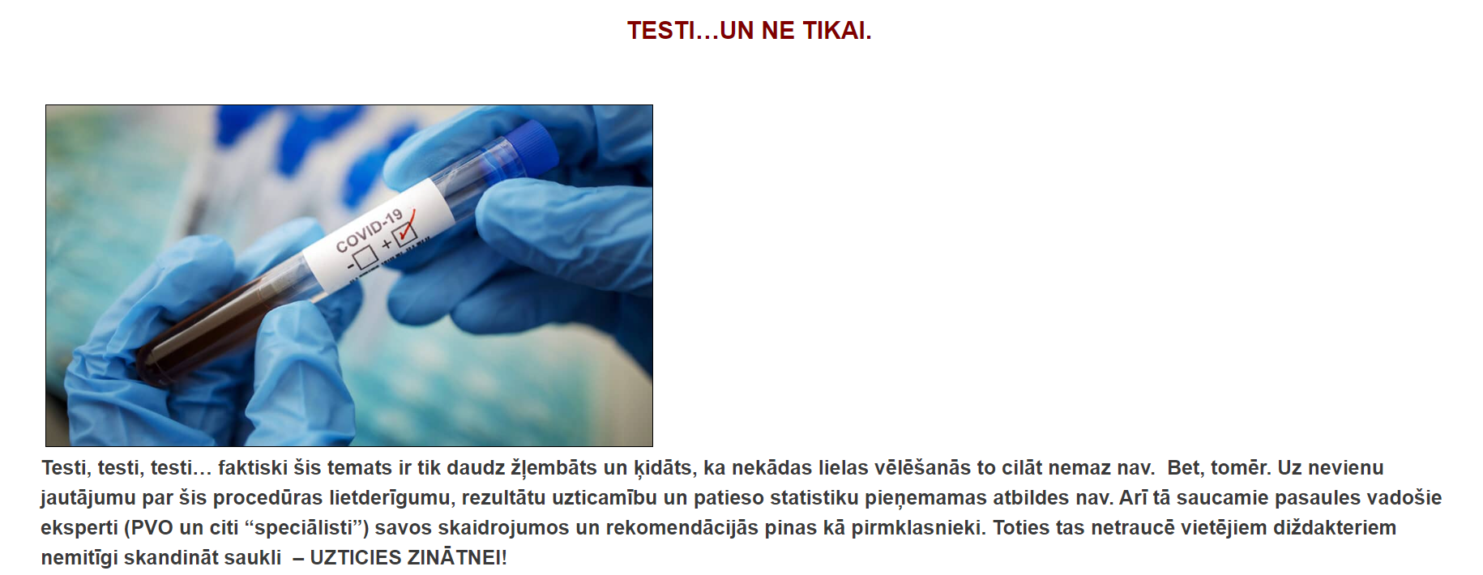
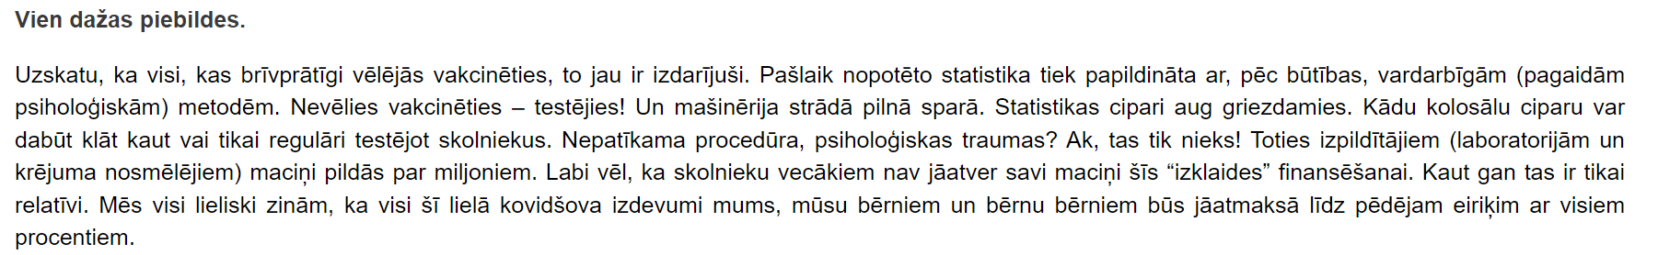
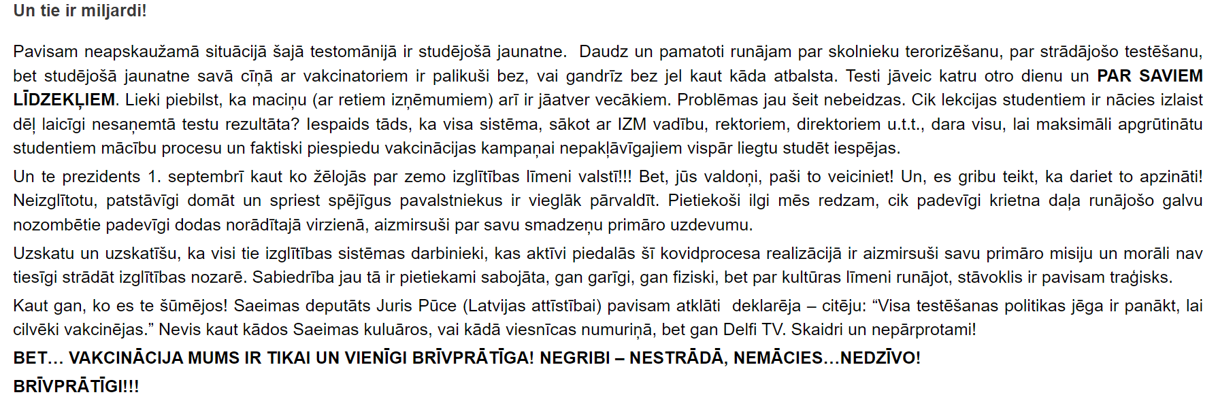
EXAMPLES OF DISINFORMATION (1)
BRĪVS CILVĒKS, n.d.
8

Slide 9

EXAMPLES OF DISINFORMATION (2)
Reval Buch, n.d.
9

Slide 10
DISCUSSION
Tell us what you found out about the example?
Which sources did you use and why?
Would you recommend reading the information on this website, in a social network group, to a friend? Why?
What difficulties did you encounter in analysing the example given?
10
Notes:
Tell us what you found out about the example – the website on which it was posted, the author of the text, the illustrations (if any) in the example, the article’s content, the people, places, and events mentioned in the article.
Which sources did you use and why?
Would you recommend reading the information on this website, in a social network group, to a friend, and why?
What difficulties did you encounter in analysing the example given?

Slide 11

REFLECTION
How did I feel doing the activity?
What knowledge/skills would have helped me to do this task better?
What difficulties did I encounter?
What did I like about doing this task?
11
Notes:
How did I feel doing the activity?
What knowledge/skills would have helped me to do this task better?
What difficulties did I encounter?
What did I like about doing this task?

Slide 12

HOMEWORK ASSIGNMENT
Find out which websites or social networking groups your relatives or friends browse the most.
Analyse the information on them for reliability using the lateral reading method.
12
Notes:
Find out which websites or social networking groups your relatives or friends browse the most.
Analyse the information on them for reliability using the lateral reading method.

